Slide 1
Garbage Collection and Memory Leak Avoidance in .NET

Slide 2








shapovalov.yuriy
@YuriyShapovalov
shapovalov.yuri@gmail.com
Yurii_Shapovalov@epam.com
linkedin.com/in/yuriyshapovalov
github.com/yuriyshapovalov
codeplex.com/yuriyshapovalov
Yuriy Shapovalov
Senior Software Engineer, EPAM (Kharkov)

Slide 3
CHAPTER 1
Issues with memory leaks.
CHAPTER 2
AGENDA
Garbage Collection in .NET
CHAPTER 3
Memory Leak root causes.
CHAPTER 4
Memory profiling and memory leak detection tools.

Slide 4
CHAPTER 1
Issues with memory leaks.
CHAPTER 2
Garbage Collection in .NET
CHAPTER 3
Memory Leak root causes.
CHAPTER 4
Memory profiling and memory leak detection tools.

Slide 5
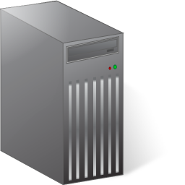

Issues with real application
Highly available server pool for B2B;
Service Bus for 3-rd party components.
Router
Server Pool

Slide 6
Issues with real application
Some servers start to work significantly slower for the same amount of requests:
2 days
3 weeks
Denial of Service periodically.
Lost of session and not committed data.
Scheduled reboot scenarios.

Slide 7

Issues with real application

Slide 8
CHAPTER 1
Issues with memory leaks.
CHAPTER 2
Garbage Collection in .NET
CHAPTER 3
Memory Leak root causes.
CHAPTER 4
Memory profiling and memory leak detection tools.

Slide 9

TRACING GC ALGORITHM
Garbage collection algorithm in .NET is based on “Tracing” algorithm which was developed for Lisp language by John McCarthy in 1960.
Also known as “Mark and Sweep”
John McCarthy
an American computer scientist and cognitive scientist

Slide 10

₁Stop all processes, run garbage collector;
₂Trace forward from the roots;
₃Everything touched is alive, anything else is garbage.

Slide 11
TRACING GC ALGORITHM
Every .NET application has a
set of roots:
static variables;
active local variables and stack roots;
CPU registers.
Application Roots
STATIC
STACK
CPU REGISTERS
Managed
Heap

Slide 12
TRACING GC ALGORITHM
Heaps might be:
Managed (.NET heap);
Unmanaged (native for OS).
Managed
Heap
Unmanaged
Heap

Slide 13
TRACING GC ALGORITHM
Application Roots
STATIC
STACK
CPU REGISTERS
Managed
Heap
Unmanaged
Heap

Slide 14
TRACING GC ALGORITHM
Application Roots
STATIC
STACK
CPU REGISTERS
Managed
Heap
Unmanaged
Heap

Slide 15
TRACING GC ALGORITHM
Application Roots
STATIC
STACK
CPU REGISTERS
Managed
Heap
Unmanaged
Heap

Slide 16
TRACING GC ALGORITHM
Application Roots
STATIC
STACK
CPU REGISTERS
Managed
Heap
Unmanaged
Heap

Slide 17
TRACING GC ALGORITHM
Application Roots
STATIC
STACK
CPU REGISTERS
Managed
Heap
Unmanaged
Heap

Slide 18
TRACING GC ALGORITHM
Application Roots
STATIC
STACK
CPU REGISTERS
Managed
Heap
Unmanaged
Heap

Slide 19
₁Younger objects dies faster;
₂Older objects live longer;
₃Garbage collection works faster for part of the heap, than for whole heap.

Slide 20
GLR has 3 generations:
0 – for new objects;
1 – for old objects;
2 – for the oldest.

Slide 21
GENERATIONS
A
B
C
D
E
0
A
B
C
D
E
0
A
B
D
1
0

Slide 22
GENERATIONS
A
B
D
F
G
H
I
J
K
1
0
A
B
D
F
G
H
I
J
K
1
0
A
D
G
H
J
2
1
0

Slide 23
FINALIZATION
Application Roots
STATIC
STACK
CPU REGISTERS
Managed
Heap
A
B
C
D
Unmanaged
Heap

Slide 24
FINALIZATION
A
Application Roots
STATIC
STACK
CPU REGISTERS
B
C
Managed
Heap
D
A
B
C
D
Unmanaged
Heap
Finalization queue
F-reachable queue

Slide 25
FINALIZATION
A
Application Roots
STATIC
STACK
CPU REGISTERS
B
C
Managed
Heap
D
A
B
C
D
Unmanaged
Heap
Finalization queue
F-reachable queue

Slide 26
FINALIZATION
Application Roots
STATIC
STACK
CPU REGISTERS
B
Managed
Heap
A
A
B
C
D
C
D
Unmanaged
Heap
Finalization queue
F-reachable queue

Slide 27
FINALIZATION
Application Roots
STATIC
STACK
CPU REGISTERS
B
Managed
Heap
B
C
D
C
D
Unmanaged
Heap
Finalization queue
F-reachable queue

Slide 28
FINALIZATION
Application Roots
STATIC
STACK
CPU REGISTERS
B
Managed
Heap
B
D
D
Unmanaged
Heap
Finalization queue
F-reachable queue

Slide 29
FINALIZATION
Application Roots
STATIC
STACK
CPU REGISTERS
B
Managed
Heap
B
Unmanaged
Heap
Finalization queue
F-reachable queue

Slide 30
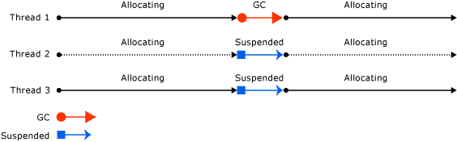
WORKSTATION VS. SERVER GC
Workstation GC

Slide 31
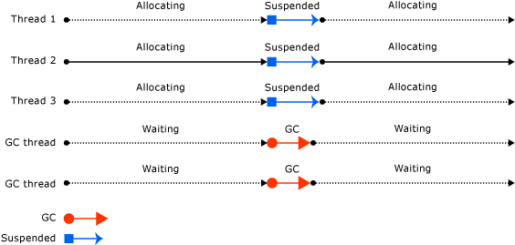
WORKSTATION VS. SERVER GC
Server GC

Slide 32
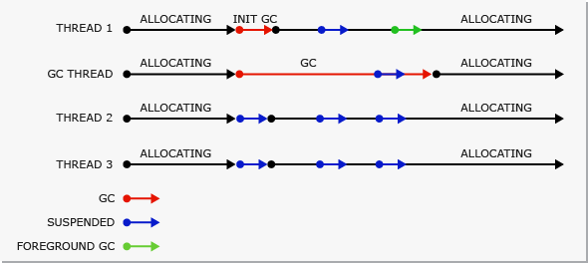
WORKSTATION VS. SERVER GC
Background Workstation GC

Slide 33
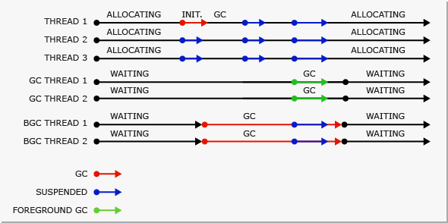
WORKSTATION VS. SERVER GC
Background Server GC

Slide 34
CHAPTER 1
Issues with memory leaks.
CHAPTER 2
Garbage Collection in .NET
CHAPTER 3
Memory Leak root causes.
CHAPTER 4
Memory profiling and memory leak detection tools.

Slide 35
₁Memory Leaks in Managed Heap;
₂Memory Leaks in Unmanaged Heap;

Slide 36



Slide 37
Memory Leak in Managed Heap
Managed Heap memory leak usually means that GC can reach the leaked object, but treat it not as garbage due to active references.
public static class SomethingFactory
{
private static List<Something> listOfSomethings = new List<Something>();
public static Something CreateSomething()
{
var something = new Something();
listOfSomethings.Add(something);
return something;
}
}

Slide 38
Memory Leak in Managed Heap
Unintended reference keeping managed object alive
Application Roots
KEEPER
Managed
Heap
…

Slide 39
Memory Leak in Managed Heap
Unintended reference keeping managed object alive
Application Roots
KEEPER
Managed
Heap
…

Slide 40
Memory Leak in Managed Heap
Unintended reference keeping managed object alive
Application Roots
KEEPER
Managed
Heap
…

Slide 41


Slide 42
Memory Leak in Managed Heap
Event Handlers might be a source of memory leaks.
MyType object2 = new MyType();
object1.SomeEvent += object2.myEventHandler;
// Should call this
// object1.SomeEvent -= object2.myEventHandler;
object2.Dispose();

Slide 43
Memory Leak in Managed Heap
Closure context variables
Application Roots
ROOT
Managed
Heap
…

Slide 44
Memory Leak in Managed Heap
Closure context variables
Application Roots
ROOT
Managed
Heap
closure
…

Slide 45
Memory Leak in Managed Heap
Closure context variables
Application Roots
ROOT
Managed
Heap
closure
…

Slide 46
Memory Leak in Managed Heap
Closure context variables
Application Roots
ROOT
Managed
Heap
closure
…

Slide 47
Memory Leak in Managed Heap
Closure context variables
Application Roots
ROOT
Managed
Heap
…

Slide 48


Slide 49
Memory Leak in Unmanaged Heap
Resource disposing omitting
Application Roots
STATIC
Managed
Heap
Unmanaged
Heap
…

Slide 50
Memory Leak in Unmanaged Heap
Resource disposing omitting
Application Roots
STATIC
Managed
Heap
Unmanaged
Heap
…

Slide 51
Memory Leak in Unmanaged Heap
Resource disposing omitting
Application Roots
STATIC
Managed
Heap
Unmanaged
Heap
…

Slide 52
Memory Leak in Unmanaged Heap
Always implement IDisposable interface for classes who using unmanaged resources.
Developer still responsible for correct resource usage.

Slide 53
Problems in highly available systems
Memory leak consume available memory on the server.
It might take one hour or a month.
Require regular server reboot.
MEMORY
AVAILABLE
MEMORY
LEAKED MEMORY

Slide 54
Performance decrease
Physical Memory
Fast Memory.
Virtual Memory
Much slower memory.
MEMORY
PHYSICAL
VIRTUAL
Application
Available
Memory

Slide 55
Performance decrease
Physical Memory
Fast Memory.
Virtual Memory
Much slower memory.
MEMORY
PHYSICAL
VIRTUAL
Application
Available
Memory

Slide 56
Performance decrease
Garbage Collector increase collecting loops (up to 50 times).
Application performance decreasing.
MEMORY
PHYSICAL
VIRTUAL
Application
Available
Memory

Slide 57
CHAPTER 1
Issues with memory leaks.
CHAPTER 2
Garbage Collection in .NET
CHAPTER 3
Memory Leak root causes.
CHAPTER 4
Memory profiling and memory leak detection tools.

Slide 58
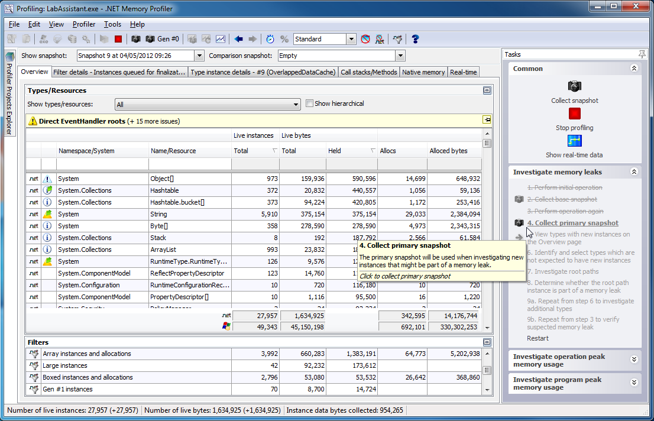
PROFILING TOOL: MEMPROFILER
₁Highly focused on memory profiling and leak detection;
₂Rich User interface;
₃Can work on production server and generate reports.

Slide 59
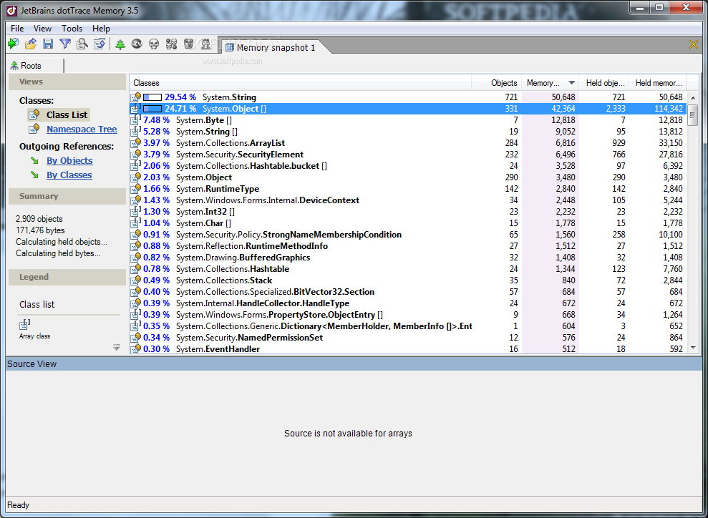
PROFILING TOOL: dotTrace Memory
₁Very convenient data representation, easy to use.
₂Provide referencing to source code which is cause memory leak;

Slide 60
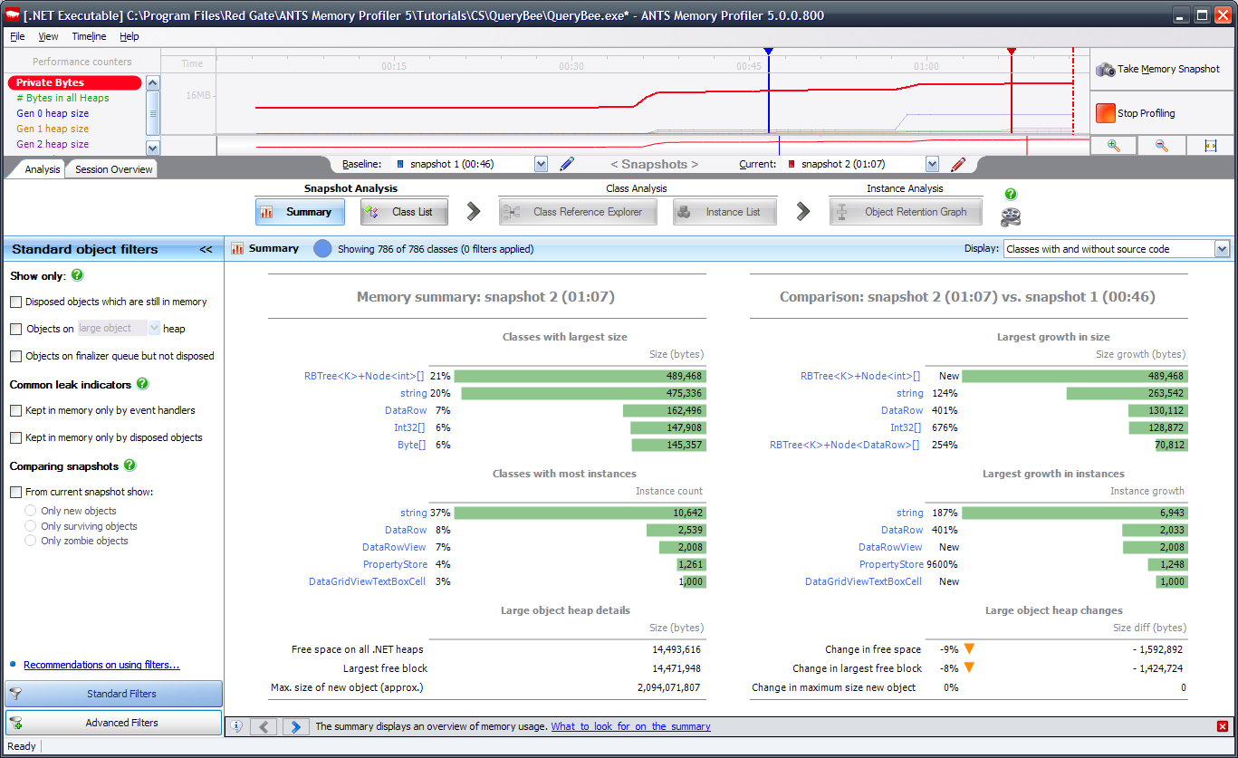
PROFILING TOOL: ANTS
₁Many useful features for memory, and performance analysis;
₂Have data access profiling in latest version;

Slide 61
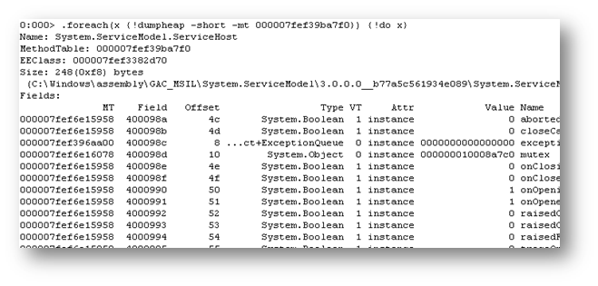
PROFILING TOOL: WinDbg + SOS
₁Easy and Free;
₂Integrated in Visual Studio;
₃Command Line interface;
₄Good for quick initial memory profiling.

Slide 62
Conclusions
₁Garbage collector works well in most cases;
₂Developers still responsible for correct resource releasing;
₃Issues with memory leaks might cause performance lacks in production;
₄Memory Profiling is a good practice;
₅Use memory leak detection strategy might save time and money.

Slide 63

Q&A

Slide 64
Yuriy Shapovalov
Senior Software Engineer, EPAM (Kharkov)
yurii_shapovalov@epam.com
shapovalov.yuriy
linkedin.com/in/yuriyshapovalov
@YuriyShapovalov

